Slide 1
NERVES AND NEURAL TISSUE
BY
Dr. F.O OPOOLA

Slide 2
INTRODUCTION
NERVES
Nerves are like cables that carry electrical impulses between your brain and the rest of your body.
These impulses help you feel sensations and move your muscles. They also maintain certain autonomic functions like breathing, sweating or digesting food.
Nerve cells are also called neurons. Neurons are present all over your body, especially in your brain and spinal cord.
Nerves, together with the brain and spinal cord, are the foundation of your nervous system.
Most of the time when doctors use the term “nerve,” they’re referring to the part of your nervous system outside of your brain and spinal cord. This is called your peripheral nervous system.

Slide 3
INTRODUCTION
Nerves
Nerves send electrical signals that help you feel sensations and move your muscles.
Nerves also control body functions like digesting food and maintaining your heart rate.
Nerves are one of the foundational parts of your nervous system.

Slide 4
Types of Nerves
two main types of nerves:
Sensory nerves carry signals to the brain to help touch, taste, smell and see.
Motor nerves carry signals to the muscles or glands to help move and function.
There are also two main groups of nerves branching out from the brain and spinal cord:
Cranial nerves: These 12 nerve pairs originate in the brain and extend through the face, head and neck.
Cranial nerves can have sensory functions, motor functions or both. For example, cranial nerves help to make facial expressions, move your eyes and process smells.

Slide 5
Spinal nerves: 31 pairs of spinal nerves branching out from the spinal cord.
These nerves can provide sensory function, motor function or both. For example, spinal nerves may carry sensations from the joints and muscles to the spinal cord.
Spinal nerves also control some of reflexes or involuntary responses, such as pulling your hand away from a hot stove.

Slide 6
Functions of the Nerves
Nerves send electrical signals from one part of the body to another. These signals control:
Voluntary movement.
Senses (touch, pain, feeling hot or cold, vibration, hearing, sense of balance, taste, smell and sight).
Blood pressure.
Breathing.
Digestion.
Heart rate.
Stress response.

Slide 7
nerves help the two parts of the nervous system communicate with each other:
peripheral nervous system is the network of nerves that transmit (carry) signals from all over the body to the spinal cord, which is part of the central nervous system.
central nervous system is the brain and spinal cord. It receives and interprets nerve signals from the peripheral nervous system.
the brain integrates these messages (inputs) to inform everything done, including movements, feeling, behavior and thinking.
Some reactions are reflexive, happening below the level of consciousness, like moving your hand away from a hot stove.

Slide 8
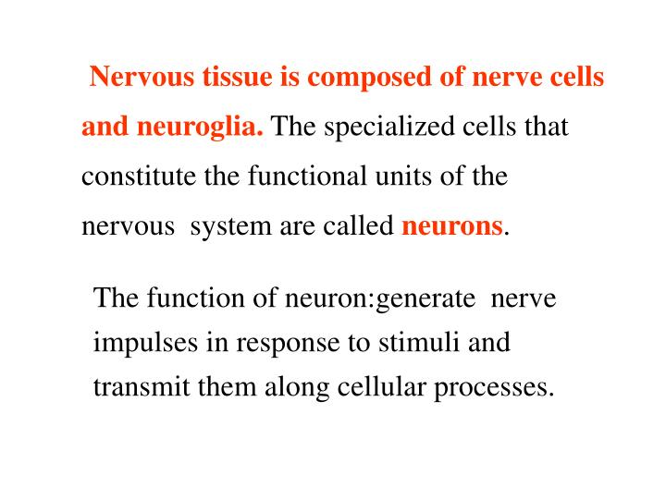

Slide 9
The nervous system allows us to perceive, understand, and respond to our environment. It comprises two different types of cells:
Nerve cells (neurones) – these form the functional basis of the nervous system, responsible for transmitting signals as electrical or chemical signals.
Glial cells – these provide functional and structural support for the neurones. One example is a Schwann cell, which produces the lipid sheath of peripheral neurones.

Slide 10
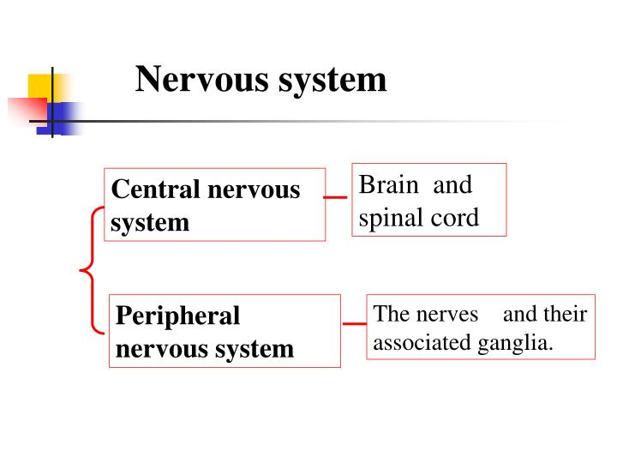

Slide 11
Neuronal Structure
There are several different types of neurones found in the nervous system. They all contain the same key structural components – the cell body, dendrites, the axon and the axon terminals.
Cell Body
The cell body holds the nucleus. It is the site of protein synthesis, which occurs on small granules of rough endoplasmic reticulum called nissl substance.
In the nervous system, many neuronal cell bodies can group together to form a distinct structure. In the CNS, this is known as a nucleus, and in the PNS as a ganglion.

Slide 12
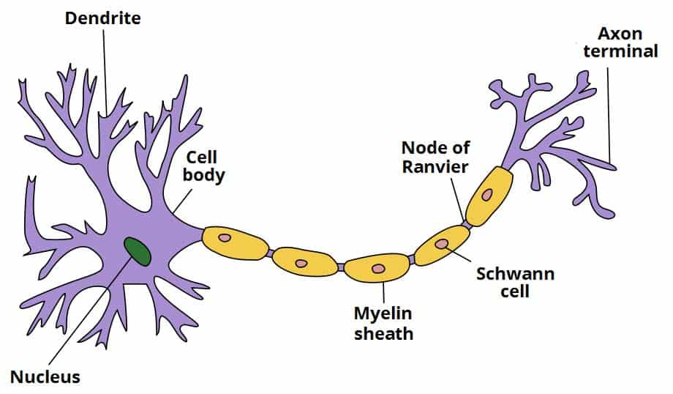

Slide 13
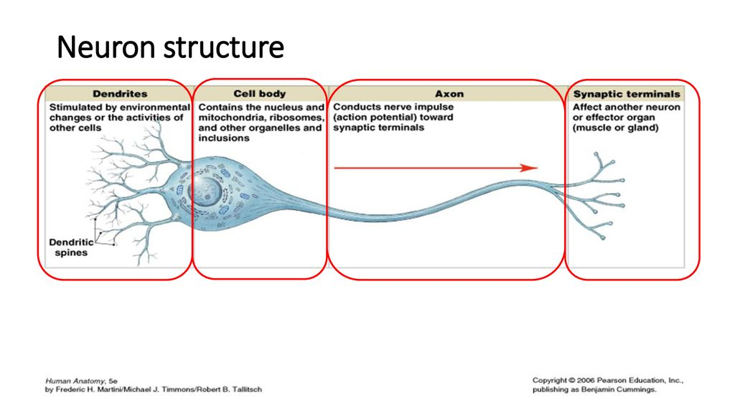

Slide 14
Dendrites
The dendrites are elongated portions of the cell body. They extend outwards, receiving input from the environment and from other neurones.
Axons
The axon is a long, thin structure down which action potentials (the nerve impulse) are conducted. Whilst neurones have many dendrites, most cells only have one axon.
Each axon is coated in myelin – a layer of insulating lipid. Myelin is formed by cells wrapping themselves around the nerve axon. In the CNS, this is performed by oligodendrocyte cells. In the PNS, Schwann cells are responsible for this action.
There are gaps between the myelin sheaths formed by different cells. These gaps are known as nodes of Ranvier. They allow for saltatory conduction of impulses.

Slide 15
Axon Terminals
The axon terminal is the most distal part of the axon. It is from here that the neurone sends chemical signals to other cells – usually via neurotransmitter release.
To facilitate the secretion of neurotransmitters, the axon terminals contain a large number of mitochondria.

Slide 16
Classification
Neurones can be classified by structure or by function. Neurones with different functions have differing structures, which is visible histologically.
Structural Classification
Neurones can be either unipolar, pseudounipolar, bipolar or multipolar.
Unipolar – Here the cell body is at one end of a single unbranched axon, and there are no dendrites. These can be found in the cochlear nucleus of the brain.
Pseudounipolar – They have one axon which is divided into two branches by the presence of the cell body. Sensory neurones are all pseudounipolar.
Bipolar – These neurones have two processes arising from a central cell body – typically one axon and one dendrite. These cells are found in the retina.
Multipolar – They have one axon and many dendrites, with a cell body displaced to one side of the axon. Motor neurones are a prime example of this.

Slide 17
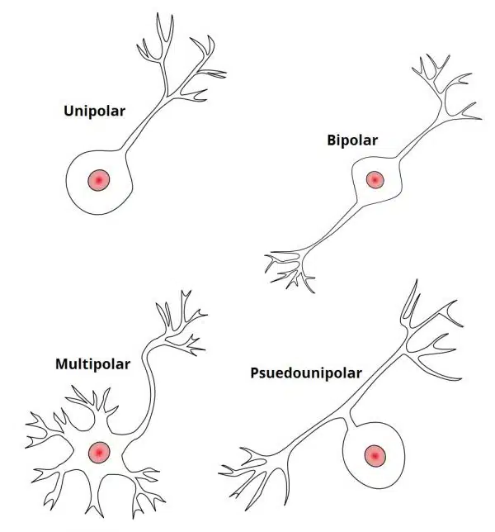

Slide 18
Functional Classification
There are three broad functional classifications of nerves – sensory (afferent), intermediate and motor (efferent). There are key structural differences between these three types:
Sensory nerves – small axons and psuedounipolar structure.
Motor nerves – larger axons and multipolar structure.
Intermediate neurones – central cell body and many dendrites.
Sensory and motor nerves are located within the PNS, whereas intermediate nerves are found in the CNS.

Slide 19
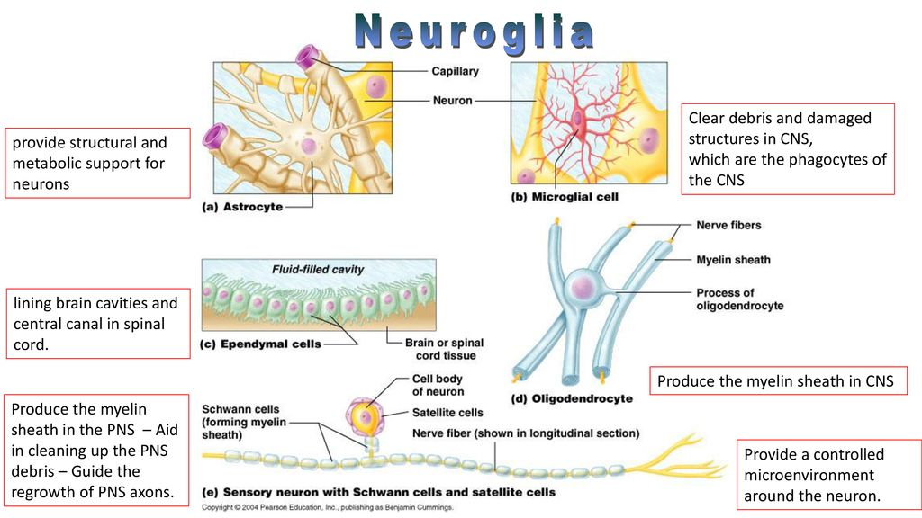

Slide 20
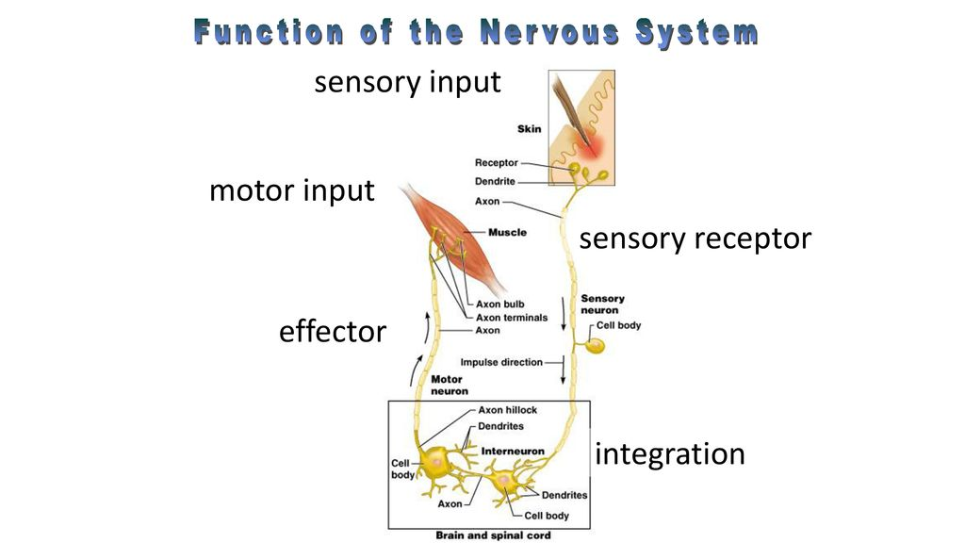

Slide 21
Clinical Relevance
Disorders of Nerve Tissue
Multiple Sclerosis
In multiple sclerosis, the myelin covering of neurones in the central nervous system is lost. This means that the relay of action potentials between sensory and motor neurones is affected. This can lead to visual, motor and auditory problems.
The etiology of Multiple Sclerosis (MS) is still uncertain. However, the causes are thought to either be as a result of autoimmune destruction of myelin, or the failure of oligodendrocytes to myelinate the interneurons.

Slide 22
Motor Neurone Disease
Motor Neurone Disease describes a group of conditions that include Amyotrophic lateral sclerosis, better known as ALS. In these diseases, motor neurones become damaged for reasons that are not entirely clear, but are thought to include dysfunctional mitochondria.
The damage to the motor neurones is progressive, making this a degenerative disease. It often begins with damage to peripheral nerves, and works its way up through the limbs until the central nervous system is compromised. This disease is fatal, with a median survival length of 3-5 years post diagnosis.

